Slide 1
Topic Modeling & Stance Detection Kenyan Parliament
Sebastian Chacon, Eric Long, Daniel Huff
CS 5322, Dr. Lin
May 8th, 2025

Slide 2
Abstract
Kenyan Parliament – Hansard Documentation
Speakers/Politicians present in each document
Tech Stack:
OCR: PyMuPDF
Topic Modeling: SBERT, BERTOPIC
Topic Outlines: OpenAI API
Stance Detection: BERT tuned on 2020 election tweets & custom trained models
Notes:
eric

Slide 3
Problem Overview
How does a Politicians background affect their decisions on bills in Senate?
Does their association with any given organization affect their voting outcome?
Can a Politician background indicate what topics they are for or against?
Notes:
Dan

Slide 4
Motivation Overview
Sebastian and Eric's job through OIT Research
Contracted by Dr. Cloward from SMU Department of Political Science
Political Applications outside of Senate, Kenyan Parliament, African Government as a whole
Notes:
seb

Slide 5


Goal & Methodology
BILLS
TOPICS
=
TEXT(992 Doc)
SPEAKER
STANCE
BIO DATA
Notes:
Seb

Slide 6
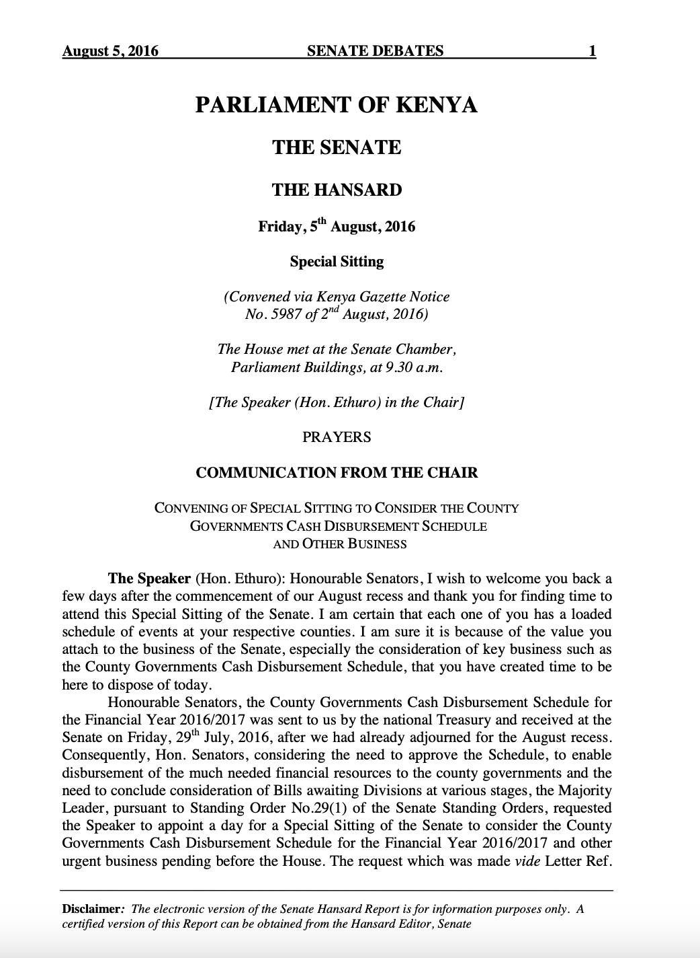
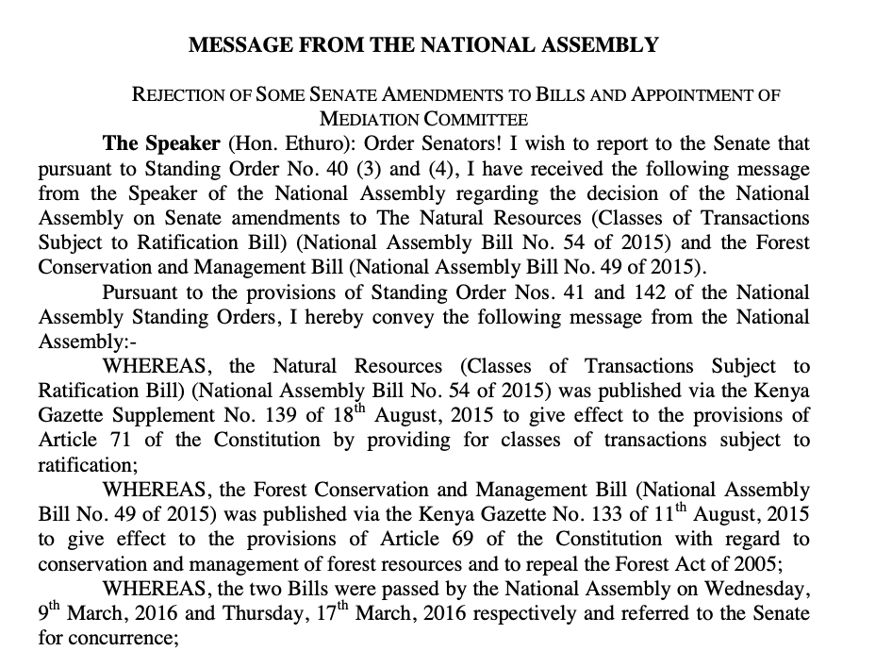
Sample Document
*Note: Voting Records only present on ~18% of documents
Notes:
Seb

Slide 7
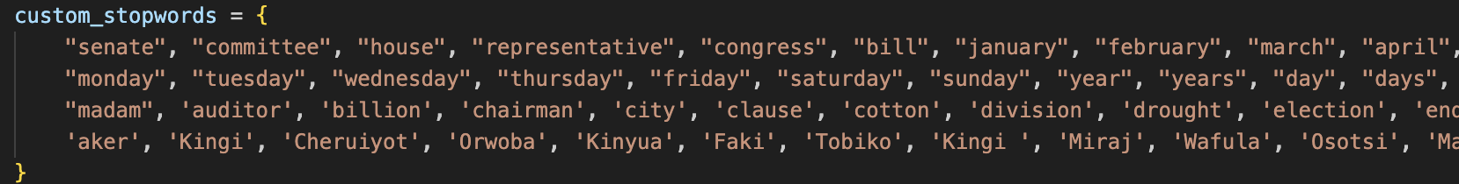
Data Limitations --> Preprocessing
Issues --> Solutions:
Translating Swihili to English --> Remove all Swahili
Porterstemmer --> Lemetization
OCR Implementation --> PyMuPDF
Standardized Hansard Data --> 80% Threshold
Notes:
Dan

Slide 8
Topic Modeling
Sebastian's Portion
Notes:
Seb

Slide 9
Topic Modeling Goal
Find Trends between our Bills (Text Docs) and Create Topics which we can then label with our given topics
Given Topics:
Marginalized Groups
Health
Environment
Elections
Corruptions
Economic Development
Taxation
Education
Parliament
Labor/Employment
Banking
Infrastructure (Water, Roads)
Land
Annual (Revenue, Finance)
Human Rights
Crime
Occupational Oversight
Courts
Agriculture
Business
Insurance
BILLS
TOPICS
Notes:
Seb

Slide 10
Topic Modeling Procedure
Data Preprocessing:
As forementioned
Embedding: Hugging Face Transformer
Maps to a 768 Dim Space: ideal for Semantic Relationships and Clustering
BERTopic
OpenAI Topic Descriptions
Label to Pre-existing Topics
Notes:
Seb

Slide 11
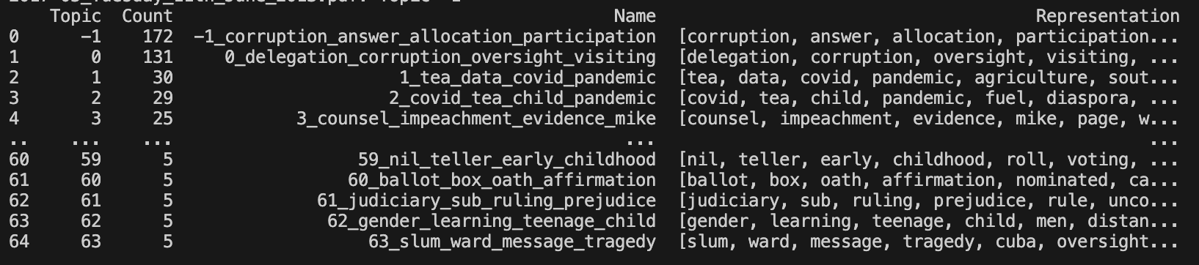
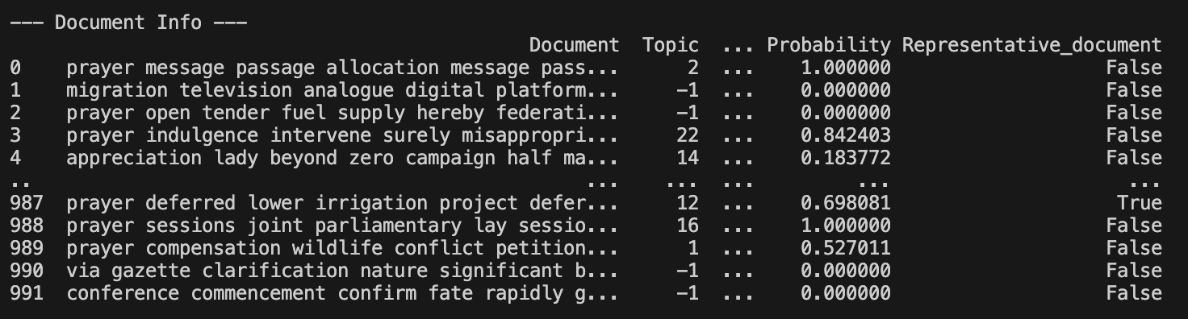
Output and Analysis
Notes:
Seb

Slide 12
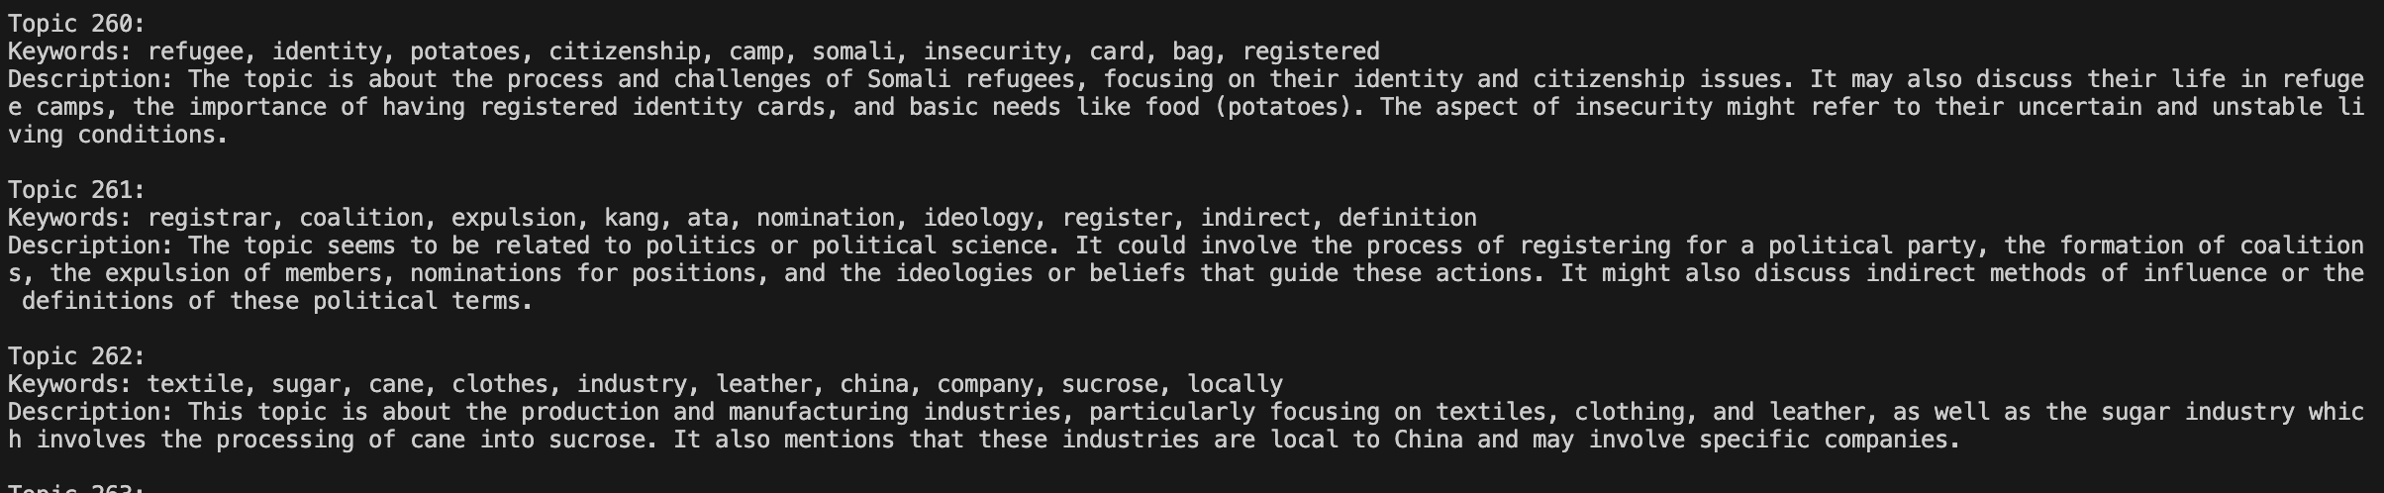
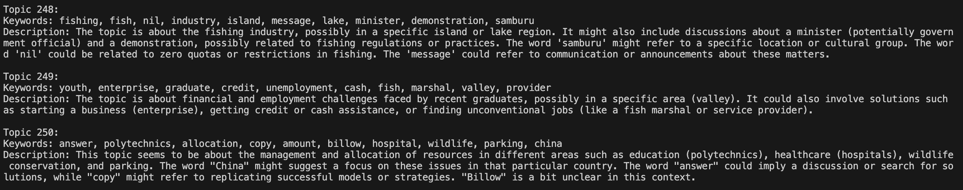
OpenAI API Description
Notes:
Seb

Slide 13
Stance detection
Dan & Eric's Portion

Slide 14
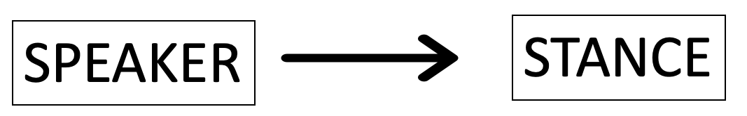
Stance Detection Goal
Identify speaker stance on a given bill
Given a bill, determine individual speakers' stances by their speech
Can verify stance with some documents based on how they voted on the bill (voting is recorded)

Slide 15
Stance Detection Procedure
UK Hansard documents
Preprocessing
Model selection: Bert 2020 Election Twitter
Grading system
Notes:
Dan
Preprocessing very tedious and extensive with hansard documents
Bert 2020 Election Twitter Stance
Trained on tweets instead of hansard date, used to much more concise wording
Forces model to pick For/against based on which is more probable
Stances are generated for each block of text
Persons stance is determined on whether or not they said more favorable or negative stances
High accuracy (>= 90%), but large

Slide 16
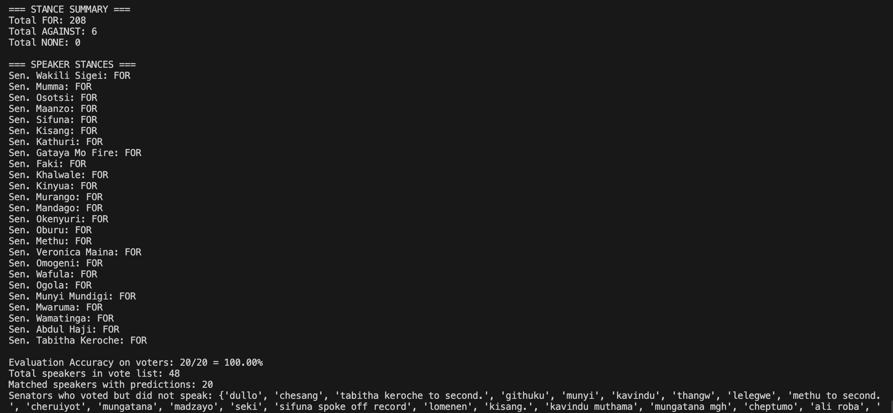
Results/ Limitations
High accuracy
Only making predictions for speakers
Typically the majority of voters do not speak
Notes:
Dan

Slide 17
Training a Stance Detection Model
Created a training dataset
Used voting records to label what each speaker said with their voting stance
Preprocessing
Removed stop words, lemmatization, BERT embeddings
Trained two classifiers
Logisitic Regression, Random Forest
Scored on Kappa and F1
Notes:
Preprocessing very tedious and extensive with hansard documents
Bert 2020 Election Twitter Stance
Trained on tweets instead of hansard date, used to much more concise wording
Forces model to pick For/against based on which is more probable
Stances are generated for each block of text
Persons stance is determined on whether or not they said more favorable or negative stances
High accuracy (>= 90%), but large

Slide 18
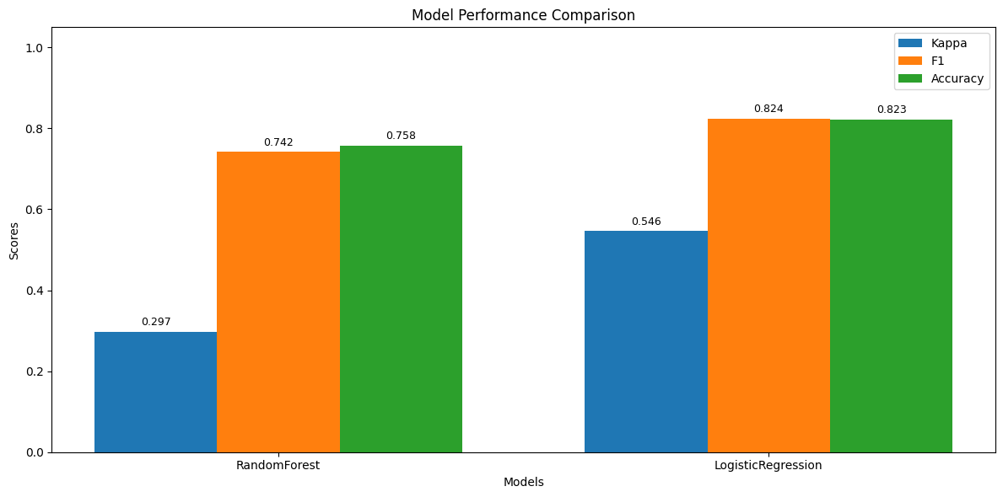
Model Results

Slide 19
Conclusion & Future Work
Moderate success on both topic modeling and stance detection
Established a baseline
Integrate Biographical data into the Stance Detection and relate to Topic Modeling
"Putting it all together"
Notes:
Dan

